Slide 1

Internship Application Manager
Bekzod Kimsanboev

Slide 2
Overview
This application is meant to be an internship application tracker for a college.
The SQL consists of 7 tables:
Department_P23
Major_P23
School_P23
Student_P23
Position_P23
Application_P23
Review_P23

Slide 3
Overview
The school has a certain number of departments and a certain number of majors from each department.
All students enrolled have a major which decides which department they belong to.
There is a number of internship positions available that are stored in Position_P23 table.
Each application submitted is saved in the Application_P23 table.

Slide 4
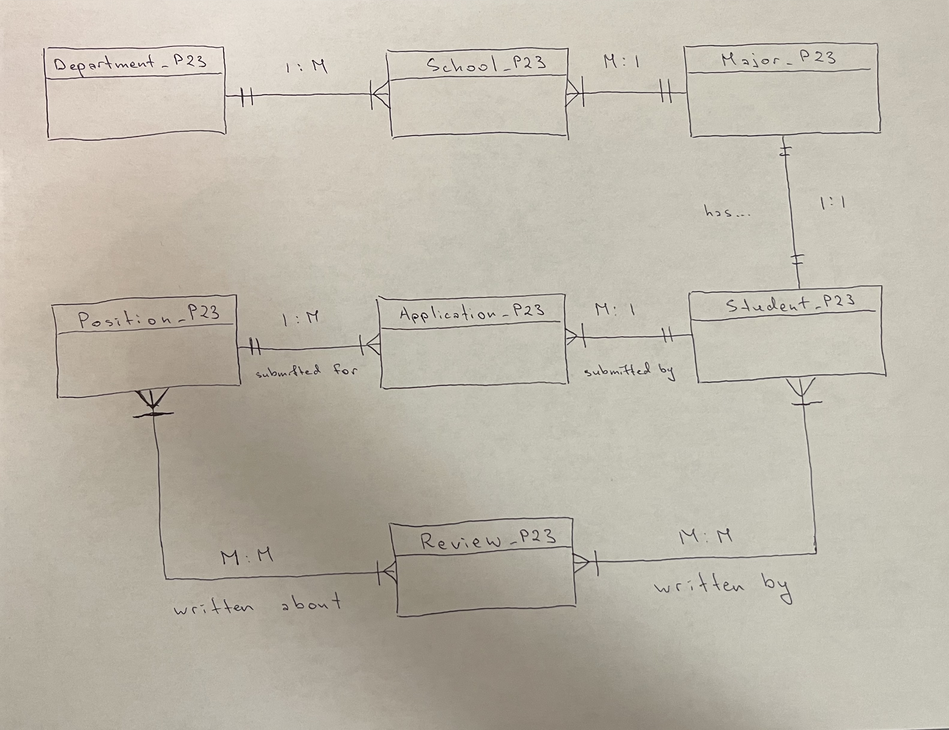
ERD

Slide 5
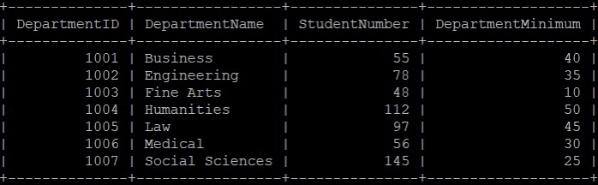
Tables Explained
Department_P23 holds the data about the different departments at school.
It consists of the following attributes:
Department ID ('DepartmentID')
Department Name ('DepartmentName')
The number of students each department has ('StudentNumber')
The minimum number of student applications each department must have ('DepartmentMinimum')

Slide 6
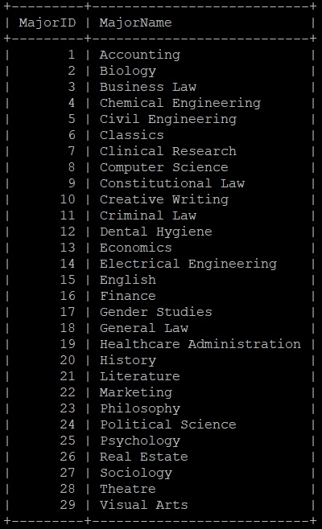
Tables Explained
Major_P23 holds data about all the available majors at school.
It consists of the following attributes:
Major Id ('MajorID')
Major Name ('MajorName')

Slide 7
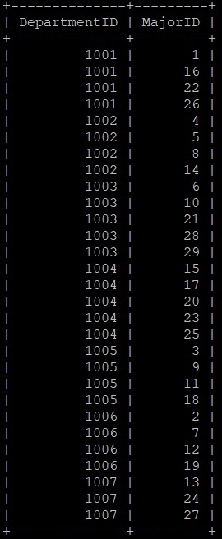
Tables Explained
School_P23 is the table that links Department_P23 and Major_p23.
This table shows which majors belong to which departments at school.
It consists of the following attributes:
Department ID ('DepartmentID')
Major ID ('MajorID')

Slide 8
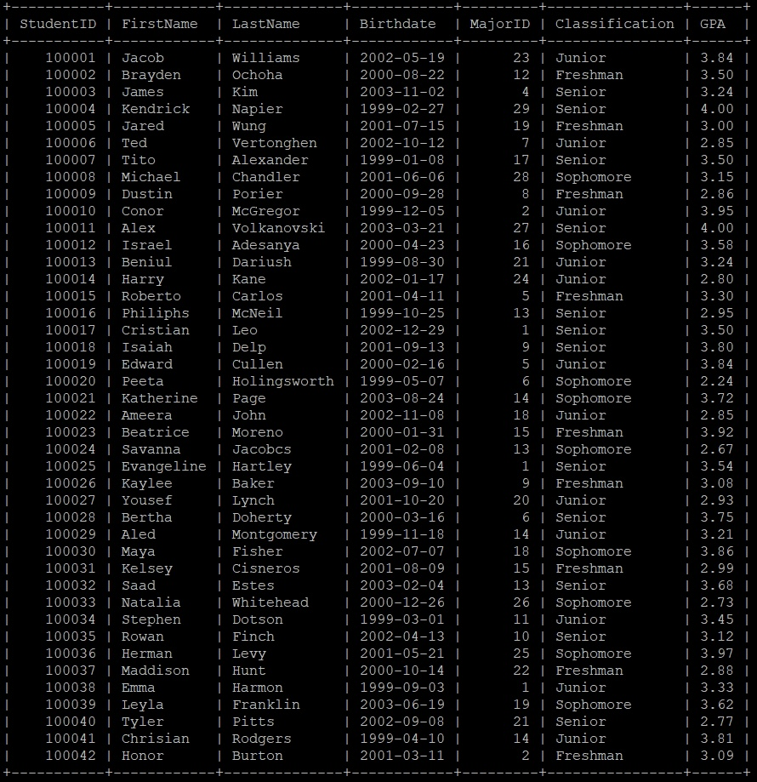
Tables Explained
Student_P23 holds all student data such as:
Student ID ('StudenID')
First Name ('FirstName')
Last Name ('LastName')
Date of Birth ('Birthdate')
Major ('MajorID')
Classification ('Classification')
GPA ('GPA')

Slide 9
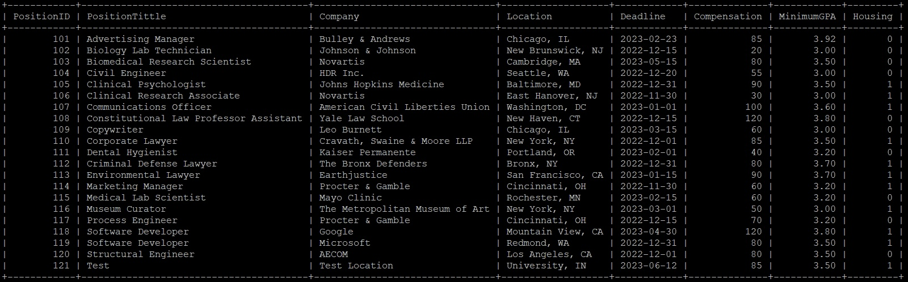
Tables Explained
Position_P23 holds data about available internship positions recommended by school:
Position ID ('PositionID')
Position Tittle ('PositionTittle')
Company ('Company')
Location ('Location')
Application Deadline ('Deadline')
Minimum GPA a student must have to be eligible ('MinimumGPA')
Housing availability ('Housing')

Slide 10
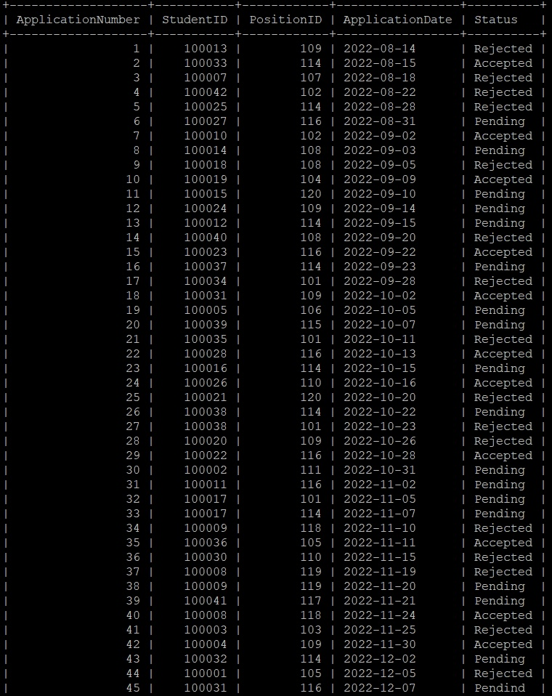
Tables Explained
Application_P23 holds data about all the applications submitted:
Application Number ('ApplicationNumber')
The applicant info ('StudentID')
Applied Internship info ('PositionID')
Date of submission ('ApplicationDate')
Status of the application ('Status')

Slide 11
***All the screenshots made up to this point are simply from "SELECT * FROM TableName" type of queries. Full queries and tables can be found in the "Select_Table.txt" file.

Slide 12
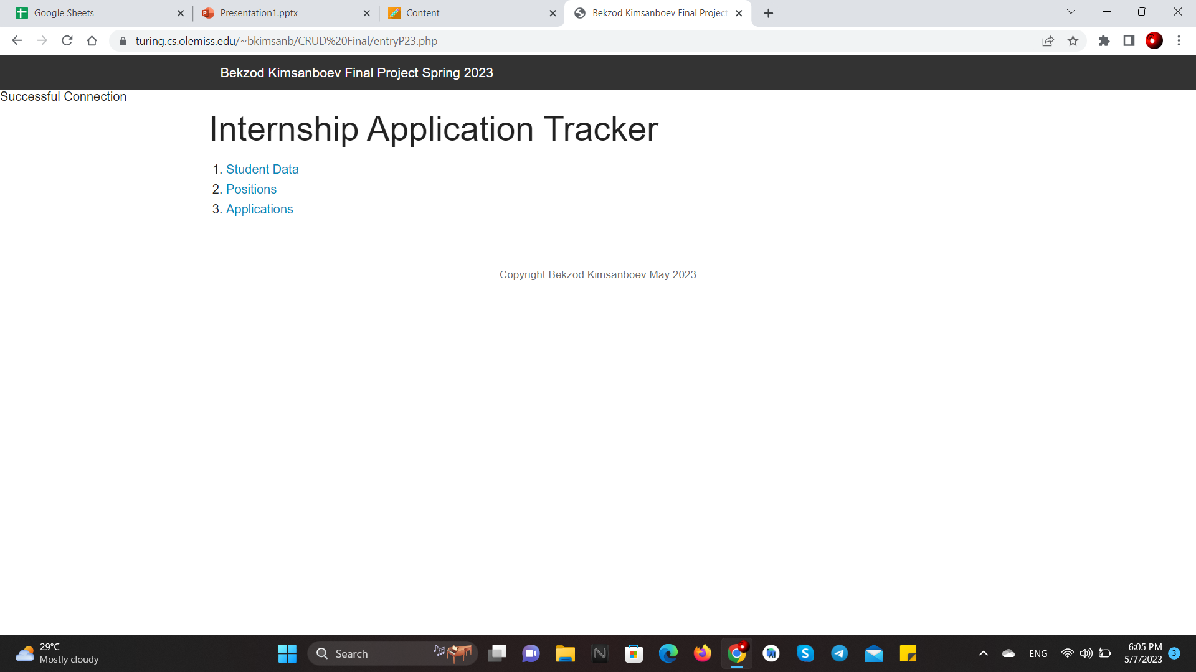
CRUD: Entry
CRUD interface starts with an entry page (entryP23.php) where you can select to see the data about the students, internship positions, and applications made.

Slide 13
CRUD: Student Data
Student Data holds the table with the data about each student.
For each student, you can choose to edit their info, which is limited to only their major since other I thought other attributes such as their name, date of birth, and classification are not to be changed since that's not something that happens very often.
Also, you can opt to delete data of any student enrolled which will consequently delete any applications submitted by them as well.
At the bottom of the page, you have an option to add a new student which will prompt to add all the required information about the student.
Finally, there is also "Back to Main Page" link available that takes you back to the Entry page.

Slide 14
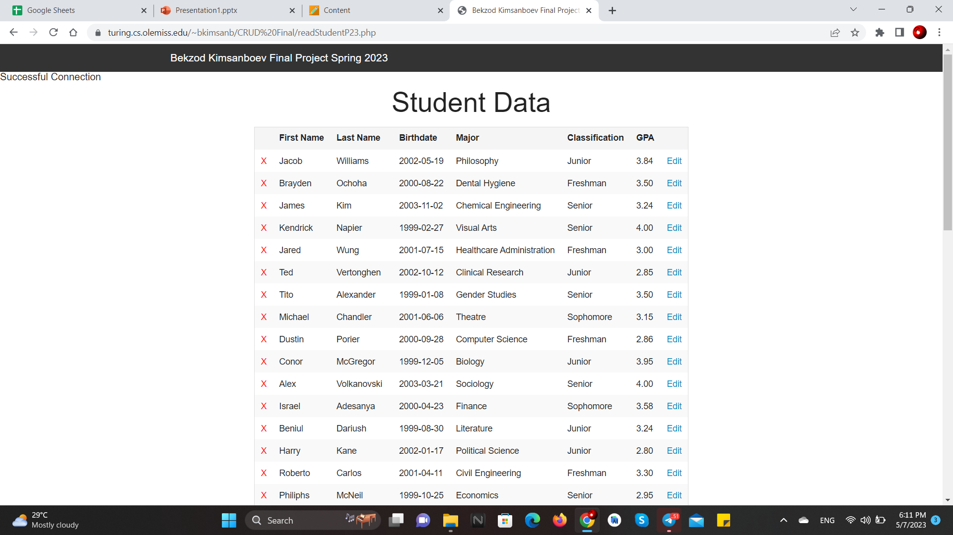
CRUD: Student Data

Slide 15
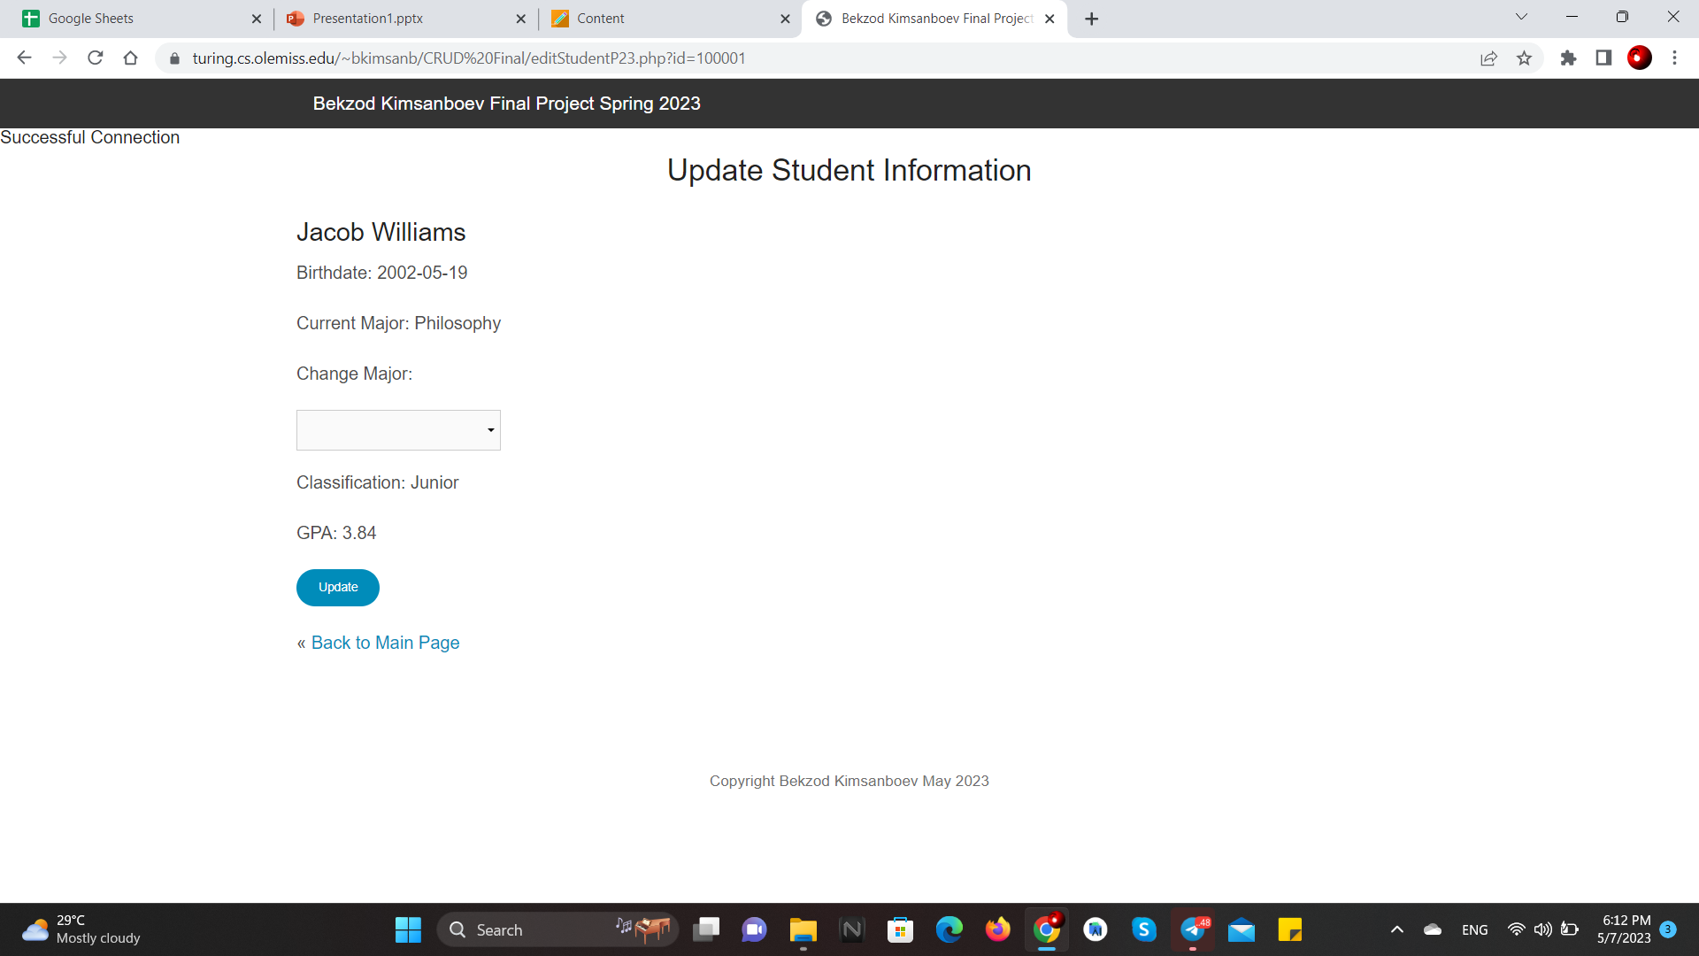
CRUD: Student Data (Edit)

Slide 16
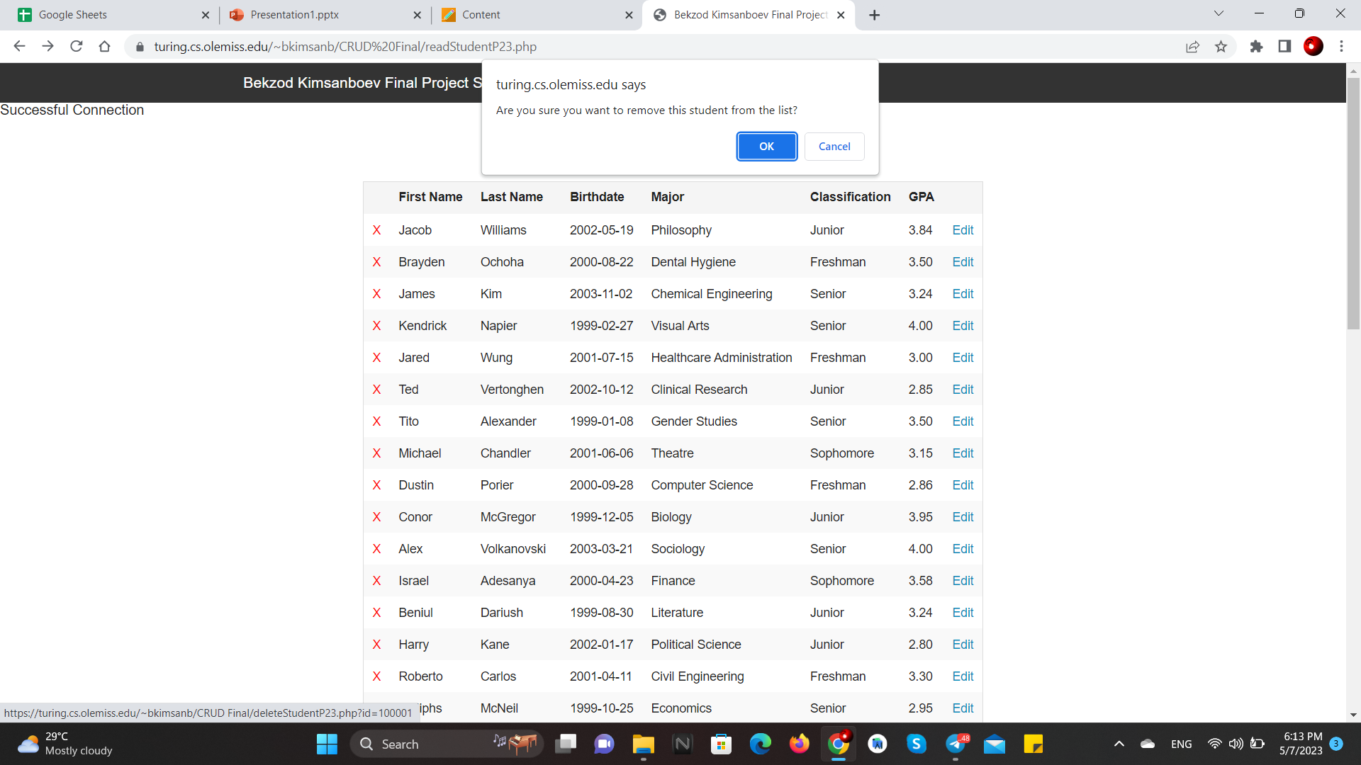
CRUD: Student Data (delete)

Slide 17
CRUD: Student Data (Add)
As previously mentioned, you must fill all the field when you are adding a new student. If you fail to do so, the page will be updated with a message saying that you must fill all the fields.
Once, every field is filled. The page will also check if you entered a correct format for student's date of birth. If you entered an incorrect date, let's say February 30 or April 31, which obviously does not exist, the page will update with a message saying you entered an incorrect date.
***The page will not let you enter February 29 since I was not able to come up with a code that check if the year entered is a leap year.

Slide 18
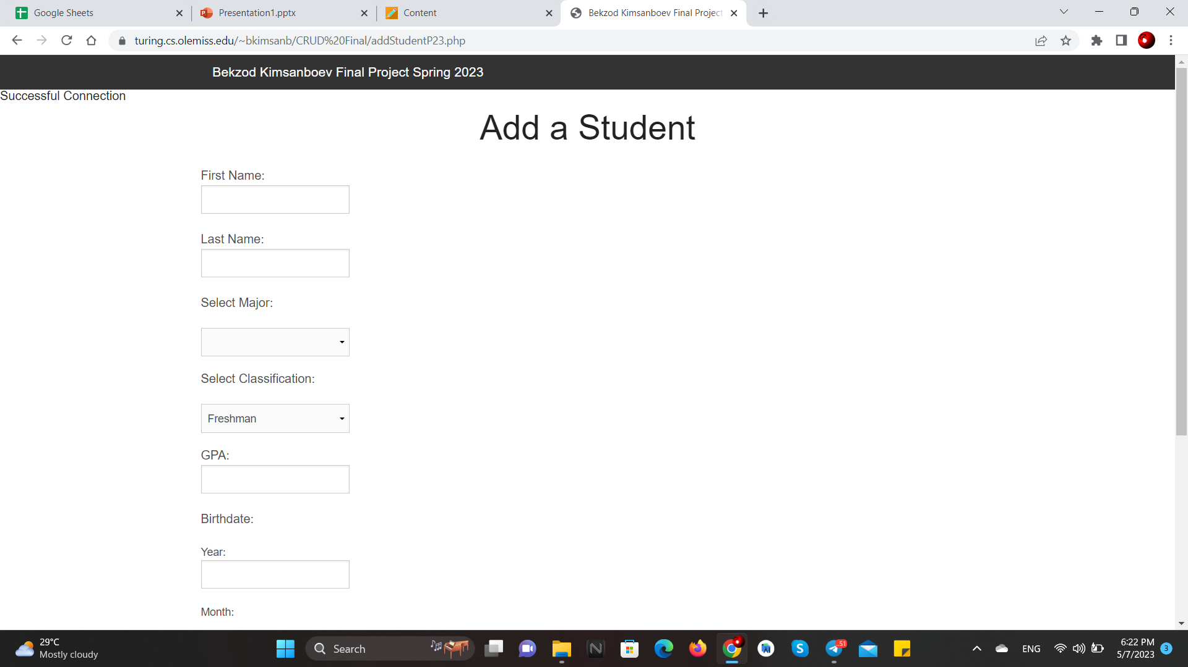
CRUD: Student Data (Add)

Slide 19
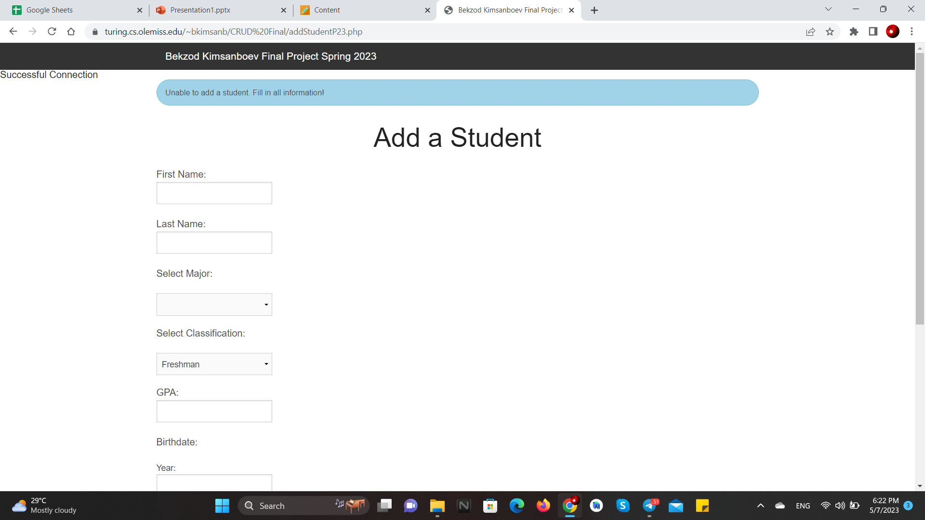
CRUD: Student Data (Add)

Slide 20
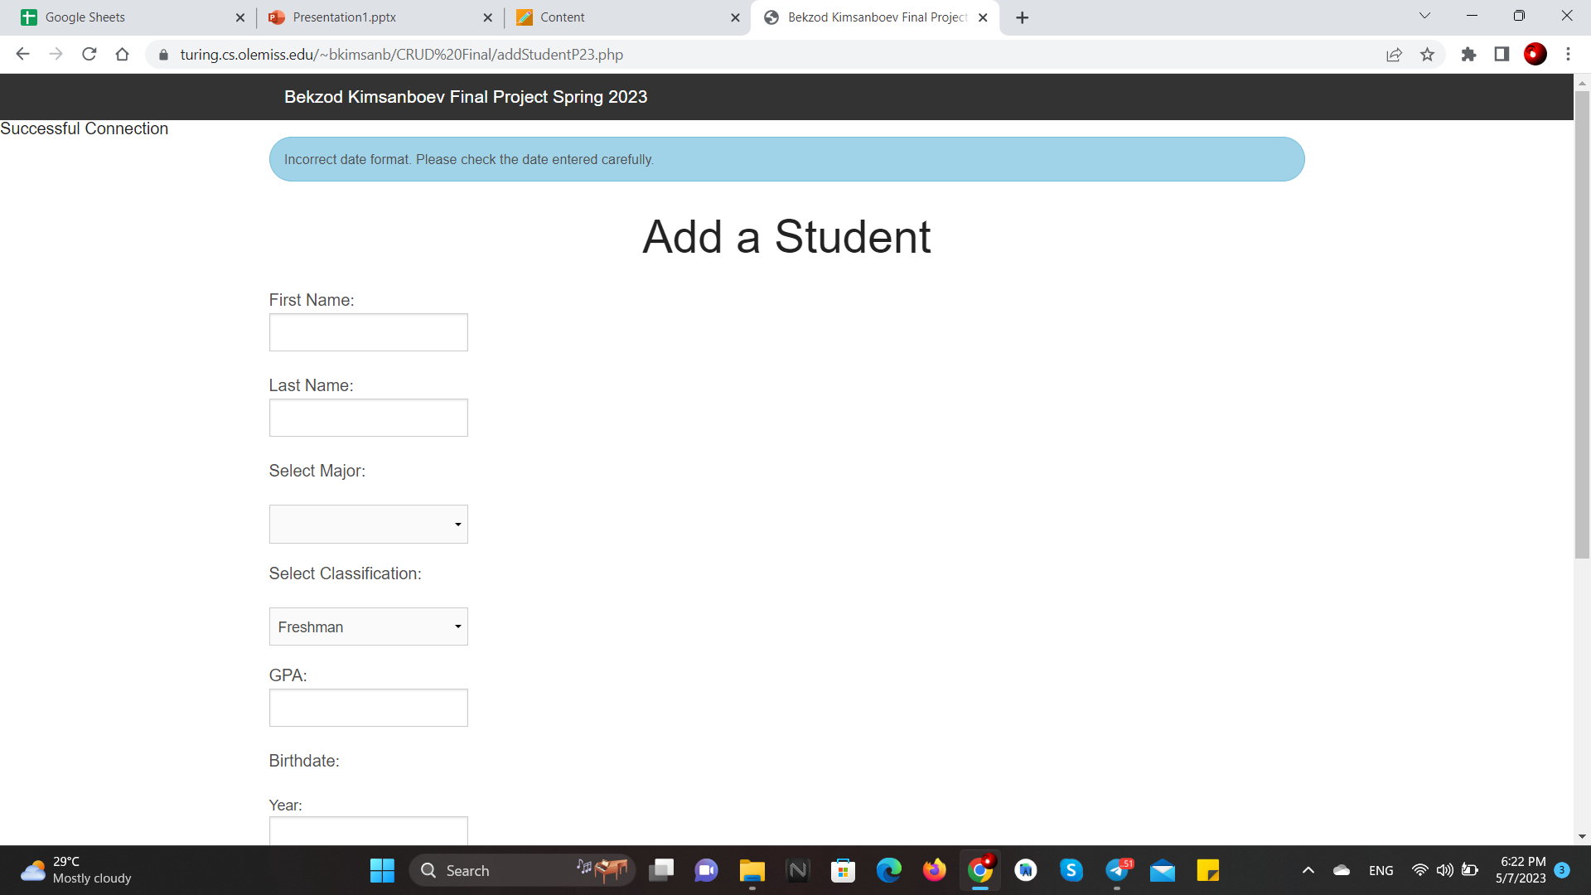
CRUD: Student Data (Add)

Slide 21
CRUD: Positions
Positions page is pretty much the same as the Student Data page.
You can add a new position, edit or delete an existing one.
When adding a new internship, you are prompted to fill all the required fields. Same as with the add student page, you may not skip any of the fields or enter an incorrect date for a deadline field such as November 31st, or February 30th.

Slide 22
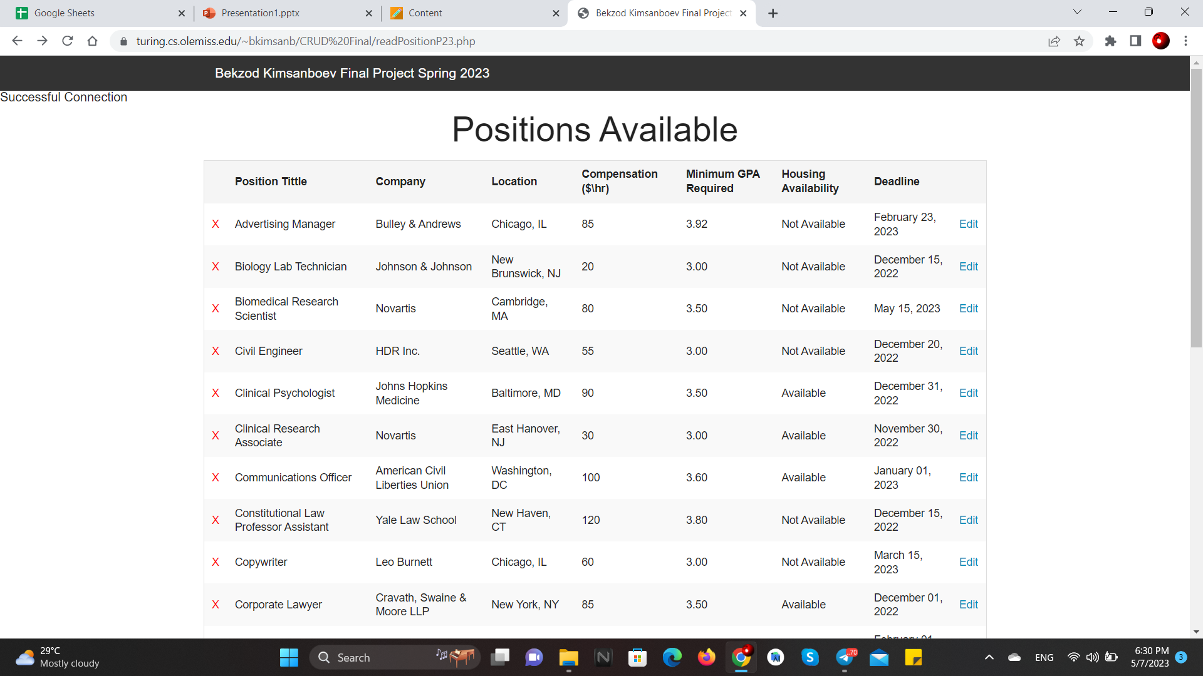
CRUD: Positions

Slide 23
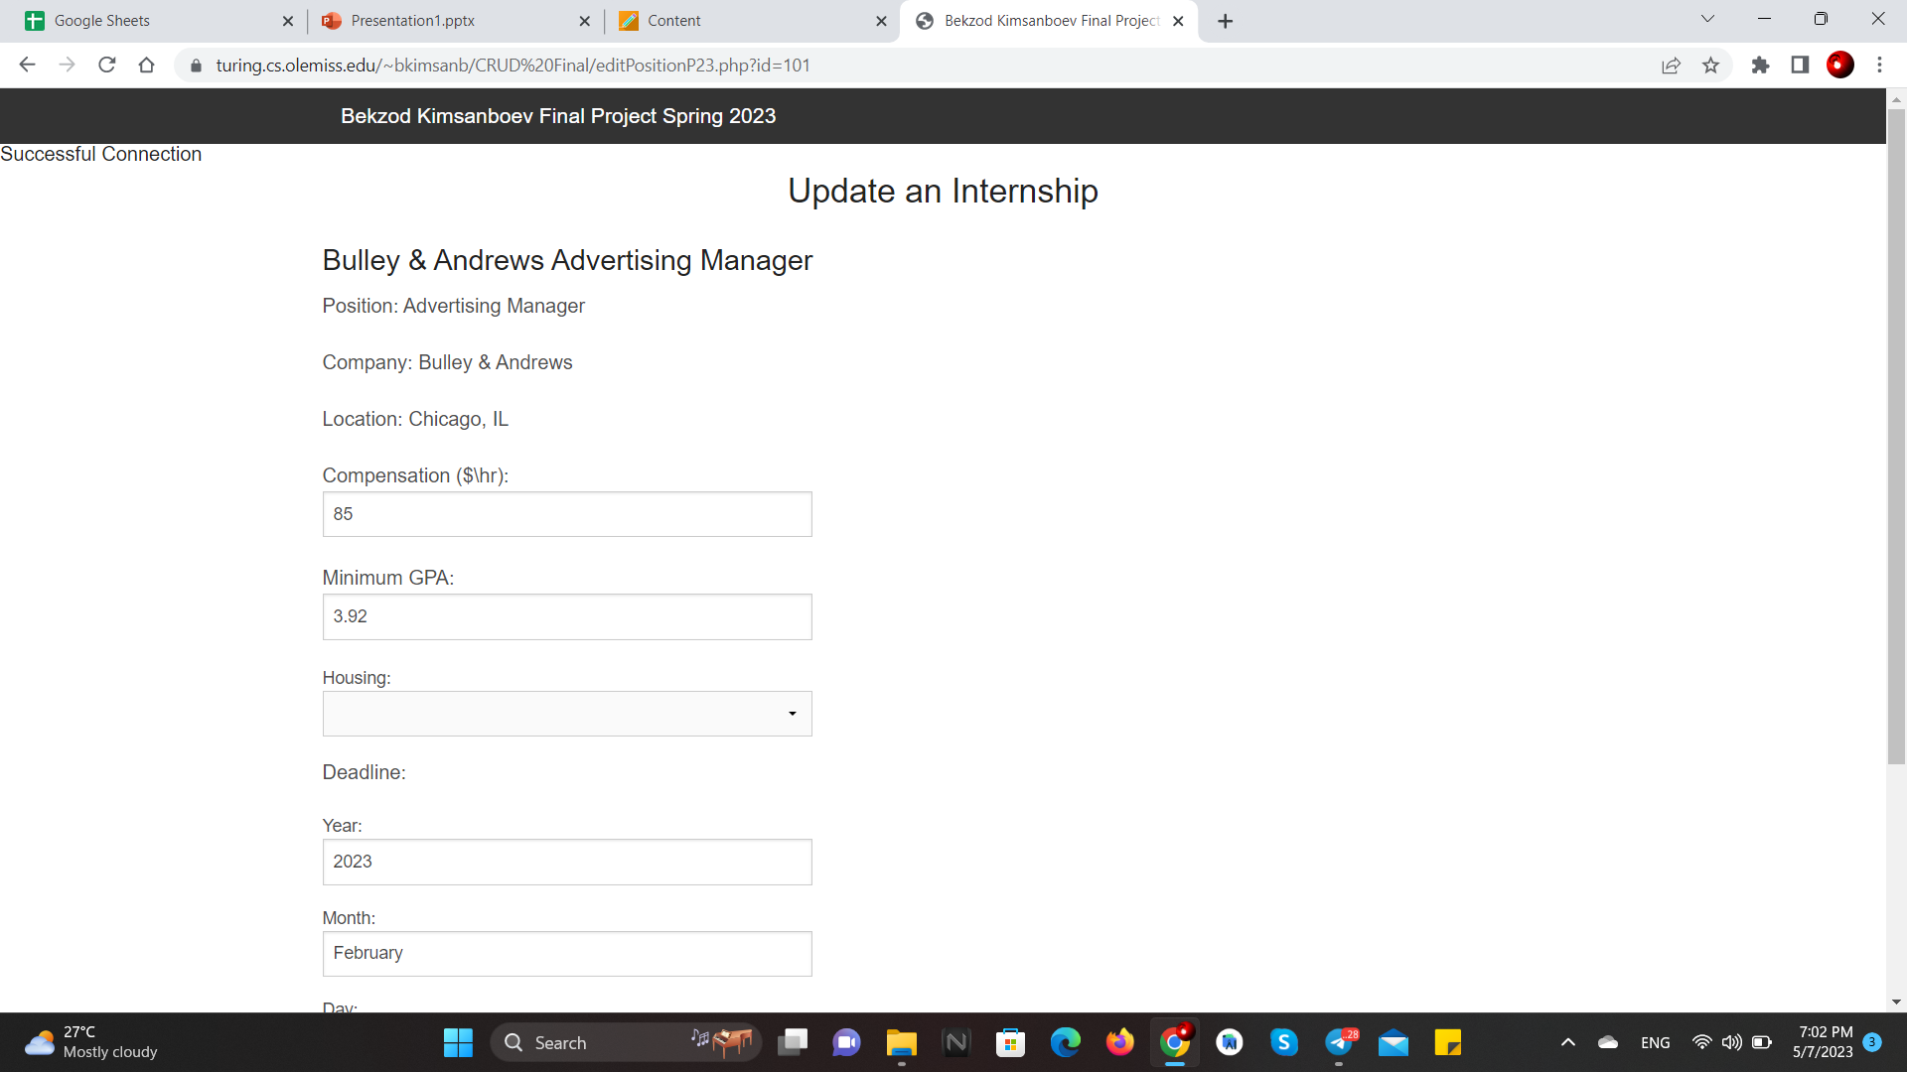
CRUD: Positions (Edit)

Slide 24
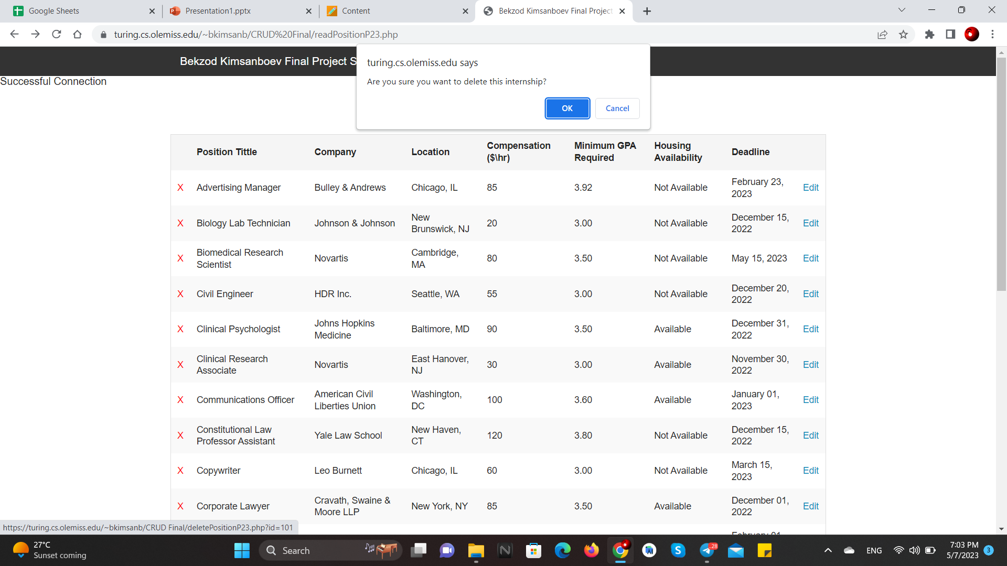
CRUD: Positions (delete)

Slide 25
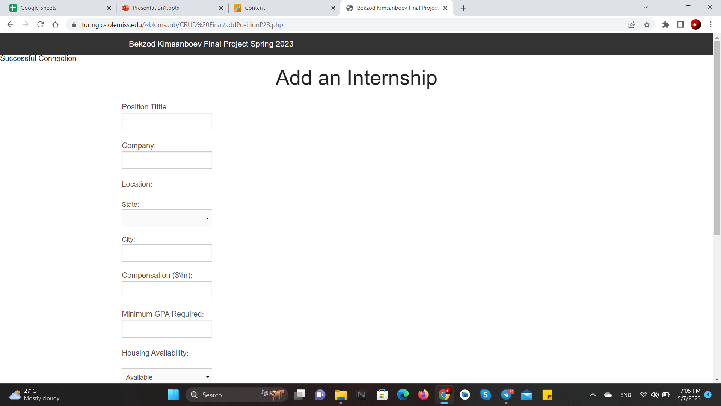
CRUD: Positions (Add)

Slide 26
CRUD: applications
Same concept as with the Student and Positions pages: you can add submit a new application, edit or delete an existing one.
When submitting a new application, you must select from an existing pool of students and positions. You enter the date of submission manually, and the status of the application is set to "Pending" automatically since it's a new application.
When selecting a student or a position, you can opt to search which directs you to either the page with the Student data or Positions data to check the student details and specifications about the position before you select them.
When submitting a new application, position minimum GPA requirement must be met by the selected student, otherwise the page refresh saying that the student does not meet the GPA requirement.

Slide 27
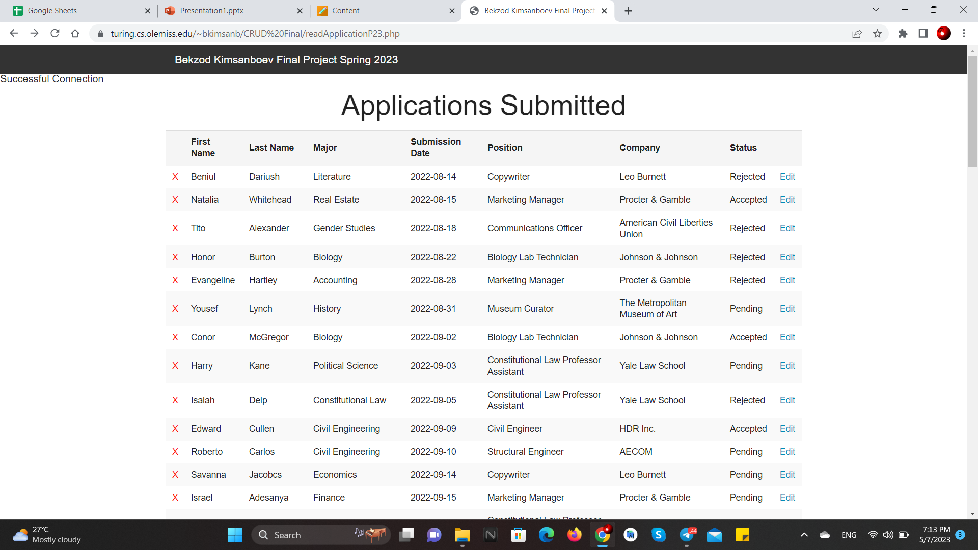
CRUD: applications

Slide 28
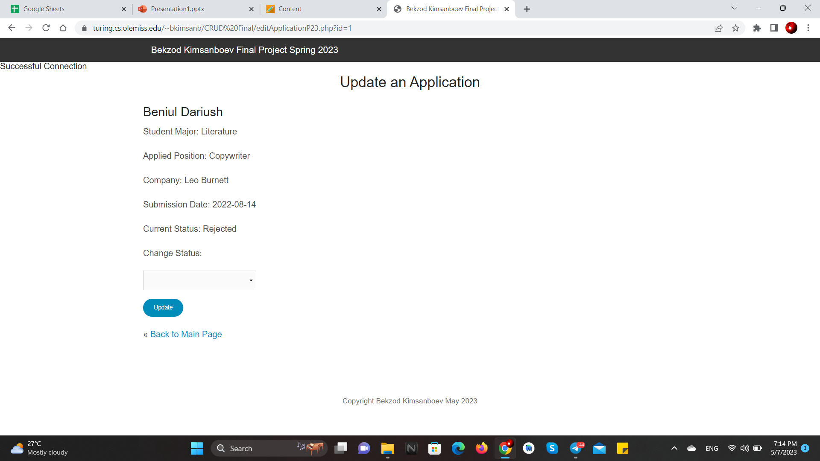
CRUD: applications (Edit)

Slide 29
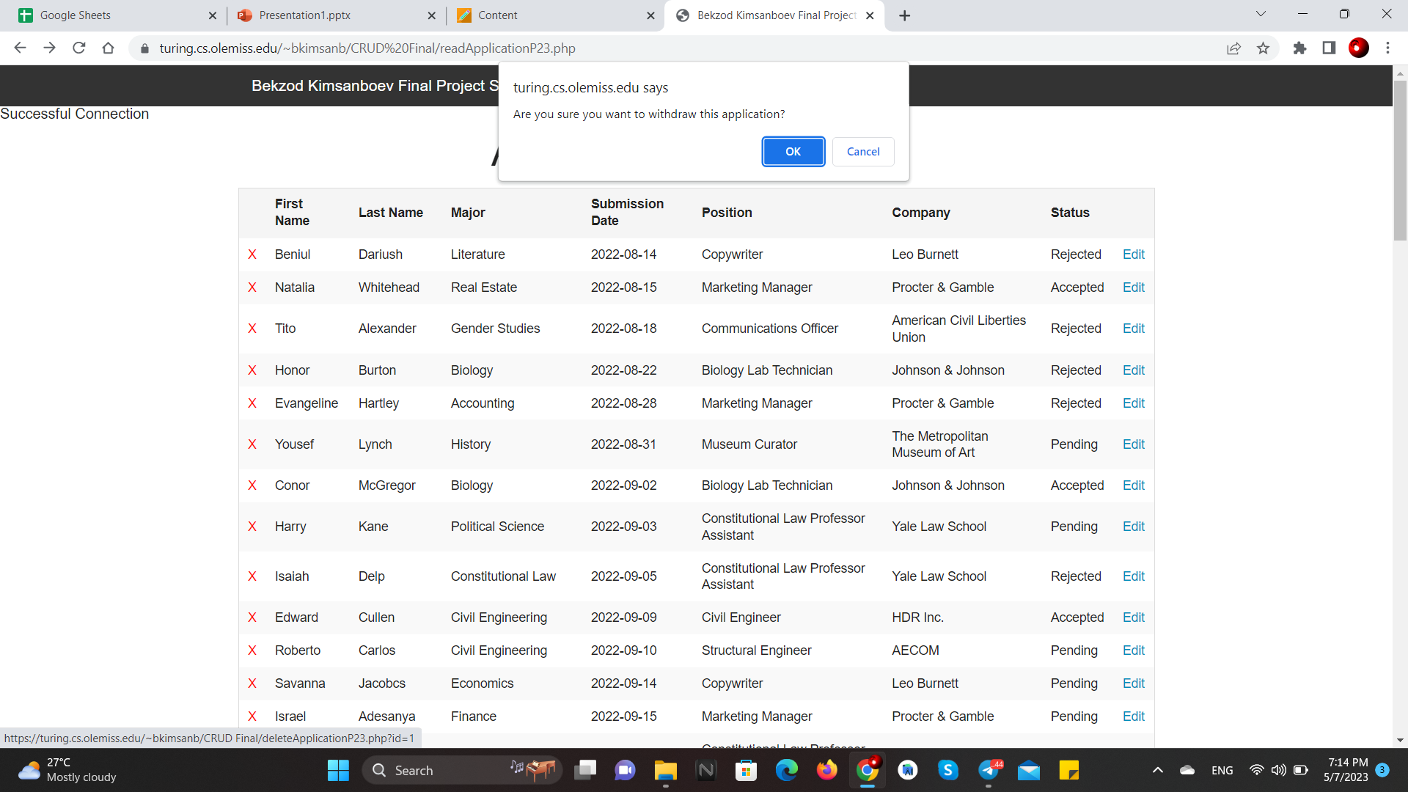
CRUD: applications (delete)

Slide 30
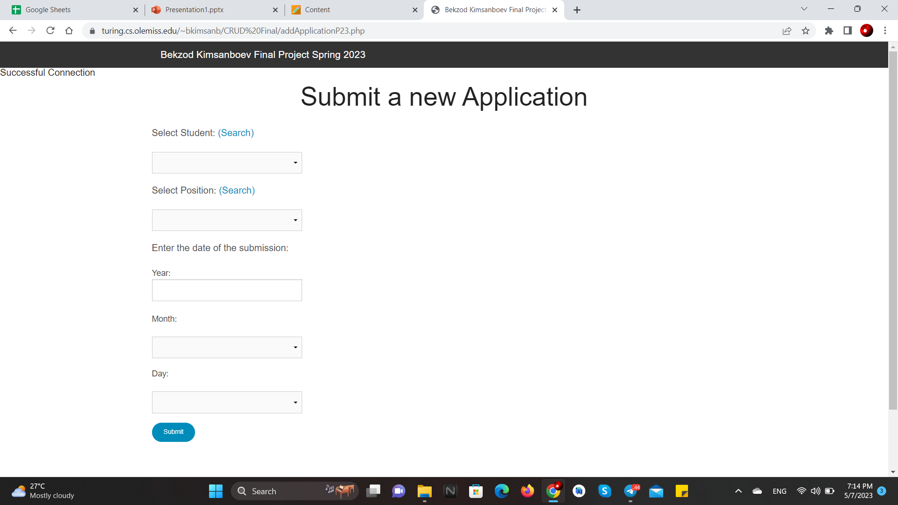
CRUD: applications (add)

Slide 31
Queries
-- QUERY 1
-- How many Applications were submitted from each Department at School?
-- 4 tables joined
SELECT School_P23.DepartmentID, DepartmentName, COUNT(Application_P23.StudentID) AS Applications FROM Application_P23 NATURAL JOIN Student_P23 RIGHT OUTER JOIN School_P23 ON Student_P23.MajorID = School_P23.MajorID RIGHT OUTER JOIN Department_P23 ON Department_P23.DepartmentID = School_P23.DepartmentID GROUP BY DepartmentID ORDER BY Applications DESC;

Slide 32
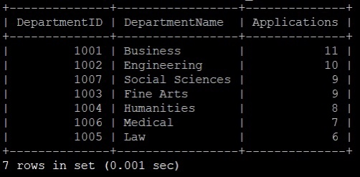
Queries
-- QUERY 1

Slide 33
Queries
-- QUERY 2
-- Select majors from the Engineering Department
-- NOTE: The First Nested Query uses a PRIMARY KEY(School_P23.DepartmentID) in its WHERE clause, however the second one does NOT(WHERE DepartmentName).
SELECT MajorName as 'Engineering Majors' FROM Major_P23 WHERE Major_P23.MajorID IN (SELECT School_P23.MajorID FROM School_P23 WHERE School_P23.DepartmentID = (SELECT Department_P23.DepartmentID FROM Department_P23 WHERE DepartmentName = "Engineering")) ORDER BY 'Engineering Majors' ASC;

Slide 34
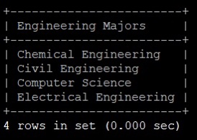
Queries
-- QUERY 2

Slide 35
Queries
-- QUERY 3
-- Select students' first names, last names, their majors, internship positions, location of the internships, and submission date from the ones that are in the Engineering Department and who are already accepted for their applied internship. Order by the date of submission.
-- 6 tables joined
SELECT FirstName, LastName, MajorName AS "Major", PositionTittle AS "Position", Location, DATE_FORMAT(ApplicationDate, '%M %d, %Y') AS "Submission Date" FROM Student_P23
NATURAL JOIN Major_P23
RIGHT OUTER JOIN School_P23 ON Student_P23.MajorID = School_P23.MajorID
RIGHT OUTER JOIN Department_P23 ON School_P23.DepartmentID = Department_P23.DepartmentID
RIGHT OUTER JOIN Application_P23 ON Application_P23.StudentID = Student_P23.StudentID
RIGHT OUTER JOIN Position_P23 ON Application_P23.PositionID = Position_P23.PositionID
WHERE Department_P23.DepartmentName = "Engineering" AND Application_P23.Status = "Accepted"
ORDER BY ApplicationDate ASC;

Slide 36
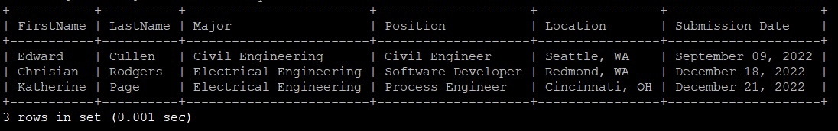
Queries
-- QUERY 3

